Slide 1
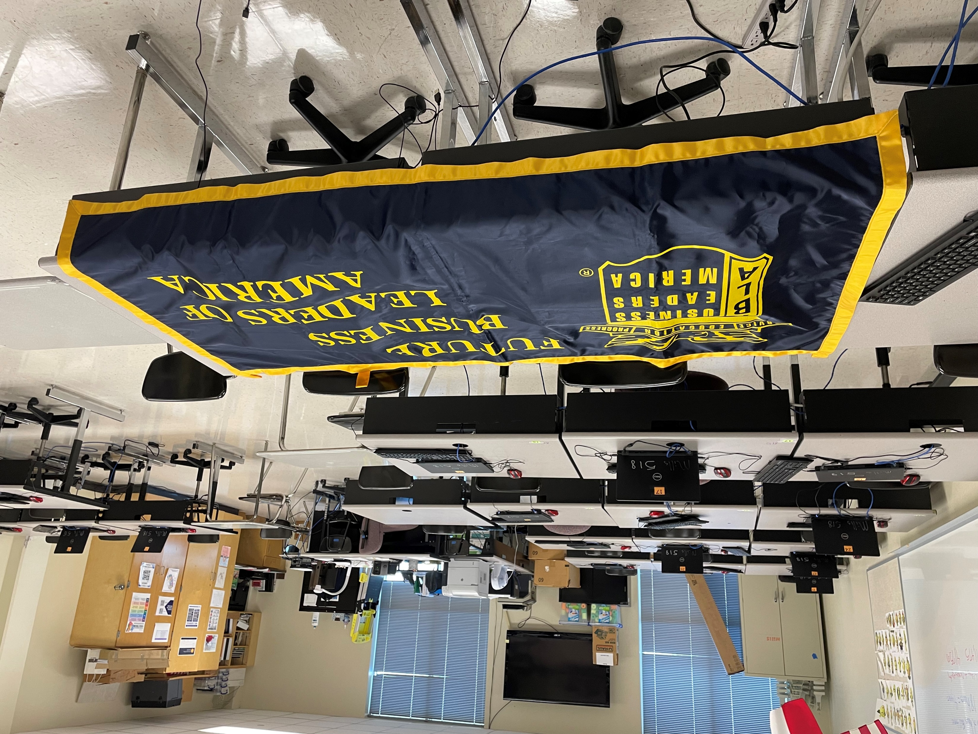
Accounting and Financial Services
Statewide Program of Study
Business, Marketing, and Finance Career Cluster
The Business, Marketing, and Finance Career Cluster focuses on careers in planning, organizing, directing, and evaluating business functions essential to efficient and productive business operations.
The Accounting and Financial Services program of study teaches CTE learners how to examine, analyze, and interpret financial records. Through this program of study, students will learn the skills necessary to perform financial services, prepare financial statements, interpret accounting records, give advice, or audit and evaluate statements prepared by others. This program of study will also introduce students to mathematical modeling tools.
Work-Based Learning and
Expanded Learning Opportunities
Secondary Courses for High School Credit
1 Business Information Mgmt. I
2 Accounting I
3 Accounting II
4 Career Preparation I
Exploration Activities | Work-Based Learning Activities
Participate in Future Business Leaders of America | Intern with a local accounting firm
Industry-Based Certifications
Intuit QuickBooks Certified User
Postsecondary Opportunities
Associates Degrees
Real Estate
Financial, General
Financial Planning and Services
Certified Income Specialist
Bachelor’s Degrees
Accounting
Financial, General
Financial Planning and Services
Certified Income Specialist
Master’s, Doctoral, and Professional Degrees
Financial Accounting
Business Administration
Financial Planning
FBLA Site for SMHS Accounting
Aligned Occupations
Occupations | Median Wage | Annual Openings | % Growth
Accountants and Auditors | $71,469 | 14,436 | 22%
Loan Officers | $68,598 | 2,419 | 19%
Personal Financial Advisors | $86,965 | 1,861 | 52%
Administrative service Managers | $96,138 | 2,277 | 21%
Insurance Underwriters | $66,206 | 594 | 14%
Successful completion of the Accounting and Financial Services program of study will fulfill requirements of the Business and Industry endorsement. Revised – August 2022

Slide 2
Accounting and Financial Services Course Information
COURSE NAME | SERVICE ID | PREREQUISITES | COREQUISITES
Business Information Management I | 13011400 (1 credit) 6340 | None | None
Accounting I | 13016600 (1 credit) 6350 | Business Information Management I | None
Accounting II | 13016700 (1 credit) 6355 | Accounting I | None
Career Preparation I | 12701300 (2 credits) 6910 | None | None
FOR ADDITIONAL INFORMATION ON THE BUSINESS, MARKETING, & FINANCE CAREER CLUSTER,
PLEASE CONTACT: CJ Odam, SMCISD CTE Coordinator cj.odam@smcisd.net
San Marcos CISD does not discriminate on the basis of race, color, national origin, sex, disability or age in its programs or activities and provides equal access to the Boy Scouts and other designated youth groups. The following person has been designated to handle inquiries regarding the nondiscrimination policies: Stephanie Munoz ; 631 Mill St, San Marcos, TX 78666 ; 512-393-6700 ; stephanie.munoz@smcisd.net
Further nondiscrimination information can be found at smcisd.net/cte

